Slide 1
Object Oriented Software Engineering (OOSE)
22CS017
Introduction to Software Engineering / Integration Testing

Slide 2
Index
Integration Testing
Validation Testing
System Testing
Object Oriented Strategies
Unit Testing in OO Context
Integration Testing in OO Context
Practice Questions

Slide 3
Integration Testing – Software Engineering
Integration testing is the process of testing the interface between two software units or modules. It focuses on determining the correctness of the interface. The purpose of integration testing is to expose faults in the interaction between integrated units. Once all the modules have been unit-tested, integration testing is performed.
Integration testing is a software testing technique that focuses on verifying the interactions and data exchange between different components or modules of a software application. The goal of integration testing is to identify any problems or bugs that arise when different components are combined and interact with each other. Integration testing is typically performed after unit testing and before system testing. It helps to identify and resolve integration issues early in the development cycle, reducing the risk of more severe and costly problems later on.
Integration testing can be done by picking module by module. This can be done so that there should be a proper sequence to be followed. And also if you don’t want to miss out on any integration scenarios then you have to follow the proper sequence. Exposing the defects is the major focus of the integration testing and the time of interaction between the integrated units.

Slide 4
Integration test approaches
There are four types of integration testing approaches. Those approaches are the following:
1. Big-Bang Integration Testing – It is the simplest integration testing approach, where all the modules are combined and the functionality is verified after the completion of individual module testing. In simple words, all the modules of the system are simply put together and tested. This approach is practicable only for very small systems. If an error is found during the integration testing, it is very difficult to localize the error as the error may potentially belong to any of the modules being integrated. So, debugging errors reported during Big Bang integration testing is very expensive to fix.
Big-bang integration testing is a software testing approach in which all components or modules of a software application are combined and tested at once. This approach is typically used when the software components have a low degree of interdependence or when there are constraints in the development environment that prevent testing individual components. The goal of big-bang integration testing is to verify the overall functionality of the system and to identify any integration problems that arise when the components are combined. While big-bang integration testing can be useful in some situations, it can also be a high-risk approach, as the complexity of the system and the number of interactions between components can make it difficult to identify and diagnose problems.

Slide 5
Advantages:
It is convenient for small systems.
Simple and straightforward approach.
Can be completed quickly.
Does not require a lot of planning or coordination.
May be suitable for small systems or projects with a low degree of interdependence between components.
Disadvantages:
There will be quite a lot of delay because you would have to wait for all the modules to be integrated.
High-risk critical modules are not isolated and tested on priority since all modules are tested at once.
Not Good for long projects.
High risk of integration problems that are difficult to identify and diagnose.
This can result in long and complex debugging and troubleshooting efforts.
This can lead to system downtime and increased development costs.
May not provide enough visibility into the interactions and data exchange between components.
This can result in a lack of confidence in the system’s stability and reliability.
This can lead to decreased efficiency and productivity.
This may result in a lack of confidence in the development team.
This can lead to system failure and decreased user satisfaction.

Slide 6
2. Bottom-Up Integration Testing – In bottom-up testing, each module at lower levels are tested with higher modules until all modules are tested. The primary purpose of this integration testing is that each subsystem tests the interfaces among various modules making up the subsystem. This integration testing uses test drivers to drive and pass appropriate data to the lower-level modules.
Advantages:
In bottom-up testing, no stubs are required.
A principal advantage of this integration testing is that several disjoint subsystems can be tested simultaneously.
It is easy to create the test conditions.
Best for applications that uses bottom up design approach.
It is Easy to observe the test results.
Disadvantages:
Driver modules must be produced.
In this testing, the complexity that occurs when the system is made up of a large number of small subsystems.
As Far modules have been created, there is no working model can be represented.

Slide 7
3. Top-Down Integration Testing – Top-down integration testing technique is used in order to simulate the behaviour of the lower-level modules that are not yet integrated. In this integration testing, testing takes place from top to bottom. First, high-level modules are tested and then low-level modules and finally integrating the low-level modules to a high level to ensure the system is working as intended.
Advantages:
Separately debugged module.
Few or no drivers needed.
It is more stable and accurate at the aggregate level.
Easier isolation of interface errors.
In this, design defects can be found in the early stages.
Disadvantages:
Needs many Stubs.
Modules at lower level are tested inadequately.
It is difficult to observe the test output.
It is difficult to stub design.

Slide 8
4. Mixed Integration Testing – A mixed integration testing is also called sandwiched integration testing. A mixed integration testing follows a combination of top down and bottom-up testing approaches. In top-down approach, testing can start only after the top-level module have been coded and unit tested. In bottom-up approach, testing can start only after the bottom level modules are ready. This sandwich or mixed approach overcomes this shortcoming of the top-down and bottom-up approaches. It is also called the hybrid integration testing. also, stubs and drivers are used in mixed integration testing.
Advantages:
Mixed approach is useful for very large projects having several sub projects.
This Sandwich approach overcomes this shortcoming of the top-down and bottom-up approaches.
Parallel test can be performed in top and bottom layer tests.
Disadvantages:
For mixed integration testing, it requires very high cost because one part has a Top-down approach while another part has a bottom-up approach.
This integration testing cannot be used for smaller systems with huge interdependence between different modules.

Slide 9
Applications:
Identify the components: Identify the individual components of your application that need to be integrated. This could include the frontend, backend, database, and any third-party services.
Create a test plan: Develop a test plan that outlines the scenarios and test cases that need to be executed to validate the integration points between the different components. This could include testing data flow, communication protocols, and error handling.
Set up test environment: Set up a test environment that mirrors the production environment as closely as possible. This will help ensure that the results of your integration tests are accurate and reliable.
Execute the tests: Execute the tests outlined in your test plan, starting with the most critical and complex scenarios. Be sure to log any defects or issues that you encounter during testing.
Analyze the results: Analyze the results of your integration tests to identify any defects or issues that need to be addressed. This may involve working with developers to fix bugs or make changes to the application architecture.
Repeat testing: Once defects have been fixed, repeat the integration testing process to ensure that the changes have been successful and that the application still works as expected.

Slide 10
Software Testing - Validation Testing
The process of evaluating software during the development process or at the end of the development process to determine whether it satisfies specified business requirements.
Validation Testing ensures that the product actually meets the client's needs. It can also be defined as to demonstrate that the product fulfills its intended use when deployed on appropriate environment.

Slide 11
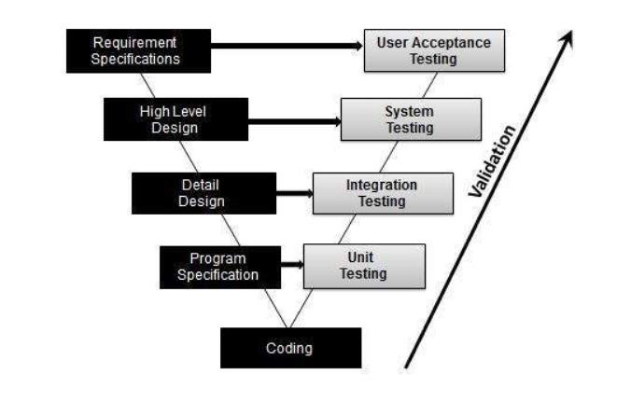
Validation Testing - Workflow:

Slide 12
System Testing
System testing is a type of software testing that evaluates the overall functionality and performance of a complete and fully integrated software solution. It tests if the system meets the specified requirements and if it is suitable for delivery to the end-users. This type of testing is performed after the integration testing and before the acceptance testing.
In system testing, integration testing passed components are taken as input. The goal of integration testing is to detect any irregularity between the units that are integrated together. System testing detects defects within both the integrated units and the whole system. The result of system testing is the observed behavior of a component or a system when it is tested. System Testing is carried out on the whole system in the context of either system requirement specifications or functional requirement specifications or in the context of both. System testing tests the design and behavior of the system and also the expectations of the customer. It is performed to test the system beyond the bounds mentioned in the software requirements specification (SRS). System Testing is basically performed by a testing team that is independent of the development team that helps to test the quality of the system impartial. It has both functional and non-functional testing. System Testing is a black-box testing. System Testing is performed after the integration testing and before the acceptance testing.

Slide 13
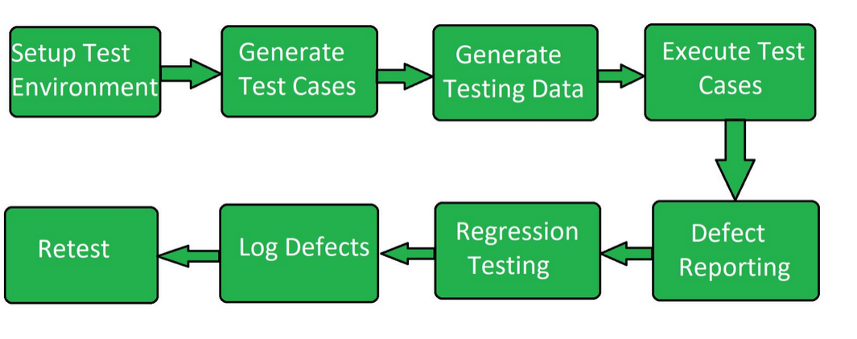
System Testing Process:
Development Model: Software can be classified as traditional software (developed using a waterfall model) or agile software (developed using an iterative and adaptive approach).
Size: Software can be classified as small-scale software (designed for a single user or small group) or enterprise software (designed for large organizations).
User Interface: Software can be classified as Graphical User Interface (GUI) software or Command-Line Interface (CLI) software.

Slide 14
Types of System Testing:
Performance Testing: Performance Testing is a type of software testing that is carried out to test the speed, scalability, stability and reliability of the software product or application.
Load Testing: Load Testing is a type of software Testing which is carried out to determine the behavior of a system or software product under extreme load.
Stress Testing: Stress Testing is a type of software testing performed to check the robustness of the system under the varying loads.
Scalability Testing: Scalability Testing is a type of software testing which is carried out to check the performance of a software application or system in terms of its capability to scale up or scale down the number of user request load.

Slide 15
Object-Oriented Testing Strategies
The classical strategy for testing computer software begins with “testing in the small” and works outward toward “testing in the large.” Stated in the jargon of software testing, we begin with unit testing, then progress toward integration testing, and culminate with validation and system testing.
In conventional applications, unit testing focuses on the smallest compilable program unit - the subprogram (e.g., module, subroutine, procedure, component). Once each of these units has been tested individually, it is integrated into a program structure while a series of regression tests are run to uncover errors due to interfacing between the modules and side effects caused by the addition of new units. Finally, the system as a whole is tested to ensure that errors in requirements are uncovered.

Slide 16
Unit Testing in the OO Context
When object-oriented software is considered, the concept of the unit changes. Encapsulation drives the definition of classes and objects.
This means that each class and each instance of a class (object) packages attributes (data) and the operations (also known as methods or services) that manipulate these data. Rather than testing an individual module, the smallest testable unit is the encapsulated class or object.
Because a class can contain a number of different operations and a particular operation may exist as part of a number of different classes, the meaning of unit testing changes dramatically.
We can no longer test a single operation in isolation (the conventional view of unit testing) but rather as part of a class.
To illustrate, consider a class hierarchy in which an operation X is defined for the superclass and is inherited by a number of subclasses. Each subclass uses operation X, but it is applied within the context of the private attributes and operations that have been defined for the subclass. Because the context in which operation X is used varies in subtle ways, it is necessary to test operation X in the context of each of the subclasses. This means that testing operation X in a vacuum (the traditional unit testing approach) is ineffective in the object-oriented context.

Slide 17
Class testing for OO software is the equivalent of unit testing for conventional software. Unlike unit testing of conventional software, which tends to focus on the algorithmic detail of a module and the data that flow across the module interface, class testing for OO software is driven by the operations encapsulated by the class and the state behavior of the class.

Slide 18
Integration Testing in the OO Context
Because object-oriented software does not have a hierarchical control structure, conventional top-down and bottom-up integration strategies have little meaning. In addition, integrating operations one at a time into a class (the conventional incremental integration approach) is often impossible because of the “direct and indirect interactions of the components that make up the class”.
There are two different strategies for integration testing of OO systems:
The first, thread-based testing, integrates the set of classes required to respond to one input or event for the system. Each thread is integrated and tested individually. Regression testing is applied to ensure that no side effects occur.
The second integration approach, use-based testing, begins the construction of the system by testing those classes (called independent classes) that use very few (if any) of server classes. After the independent classes are tested, the next layer of classes, called dependent classes, that use the independent classes are tested.
This sequence of testing layers of dependent classes continues until the entire system is constructed. Unlike conventional integration, the use of drivers and stubs as replacement operations is to be avoided, when possible.
Cluster testing is one step in the integration testing of OO software. Here, a cluster of collaborating classes (determined by examining the CRC and object-relationship model) is exercised by designing test cases that attempt to uncover errors in the collaborations.

Slide 19
Practice Questions
What is object-oriented software engineering?
What is thread-based testing?
What is use-based testing?
What is state behavior of the class?
Difference between Unit testing and Integrating testing?

Slide 20
Bibliography
https://www.geeksforgeeks.org/software-engineering-integration-testing/
https://www.tutorialspoint.com/software_testing_dictionary/validation_testing.htm
https://www.geeksforgeeks.org/system-testing/
https://www.google.com/url?sa=t&rct=j&q=&esrc=s&source=web&cd=&ved=2ahUKEwjp2ICHtOKDAxUUZfUHHZMxCBUQFnoECAgQAw&url=https%3A%2F%2Fwww.uobabylon.edu.iq%2Feprints%2Fpubdoc_3_18579_6175.docx&usg=AOvVaw04H2kfQ99T3dIwHNZ2tuYT&opi=89978449

